Slide 1

Impulses
Game 256

Slide 2
Overview
Force
Linear Impulse
Integrals
Inertia
Angular Impulse

Slide 3

Force
Force as mass times acceleration: $F=ma$
Force with acceleration definition: $F=m\frac{∆v}{∆t}$
Impulse equation: $F∆t=m∆v$

Slide 4
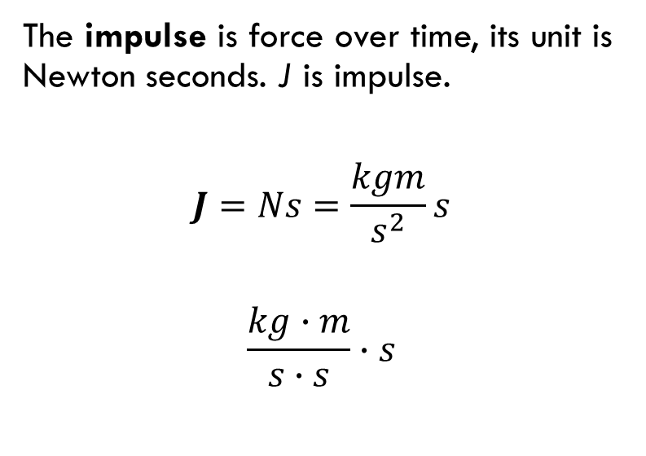

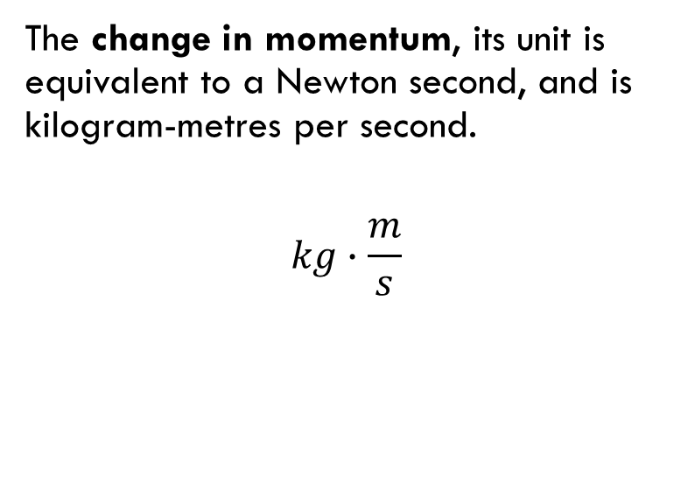

Linear Impulse
$$F∆t$$
$$m∆v$$
The impulse is force over time, its unit is Newton seconds. J is impulse.
$$J=Ns=\frac{kgm}{s^{2}}s$$
$$\frac{kg∙m}{s∙s}∙s$$
The change in momentum, its unit is equivalent to a Newton second, and is kilogram-metres per second.
$$kg∙\frac{m}{s}$$

Slide 5
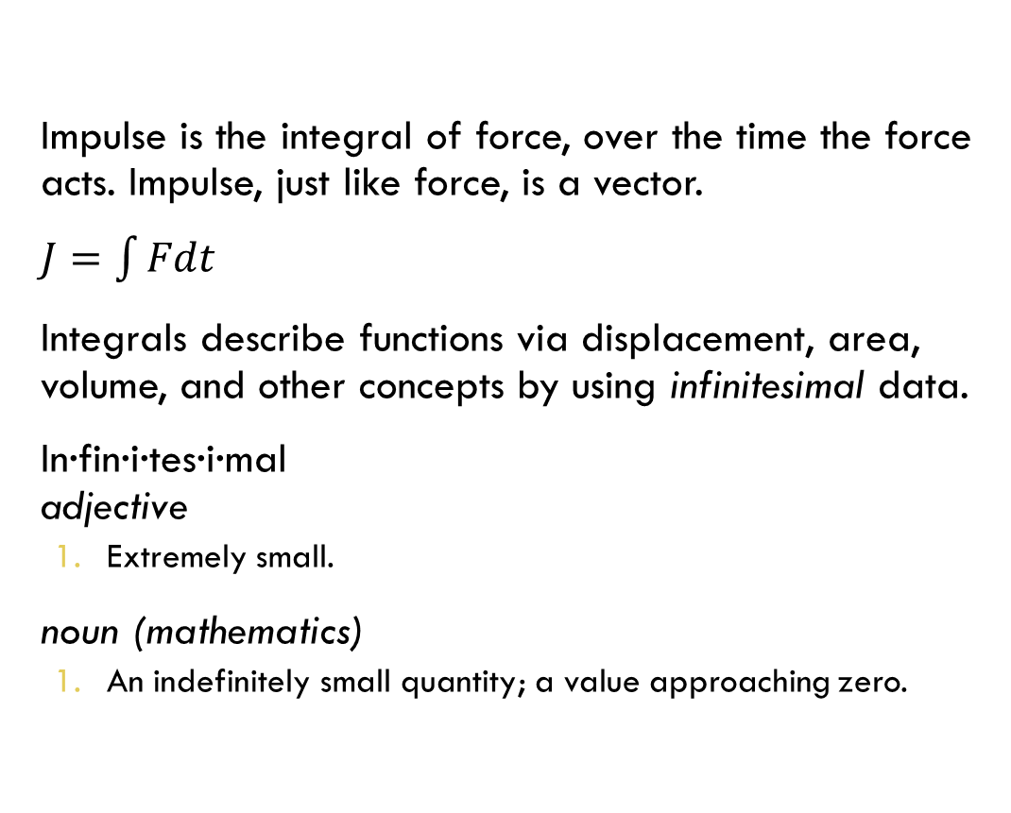
Linear Impulse & Integrals
Impulse is the integral of force, over the time the force acts. Impulse, just like force, is a vector.
$J=\int{Fdt}$
Integrals describe functions via displacement, area, volume, and other concepts by using infinitesimal data.
In∙fin∙i∙tes∙i∙mal
adjective
  Extremely small.
noun (mathematics)
  An indefinitely small quantity; a value approaching zero.

Slide 6
Integrals
In this case the whole function is ‘above’ the x axis, so the integral is the sum of all the infinitesimal areas.
Any area that goes below the x axis is subtracted, and area that goes above the x axis is added.
This is the definition of a definite integral.

Slide 7
Integrals and Change
If impulse is the rate of change of force over time, and it is the integral of force, we could derive that integrals measure the rate of change of a function.
In impulse’s case the function is force.

Slide 8

Inertia
Angular momentum as moment of inertia times angular velocity $L=Iω$
Sum of torques $\sum{τ=Iα}$
Angular acceleration as change in velocity over time $α=\frac{ω_{f}−ω_{i}}{t}=\frac{∆ω}{t}$
Angular impulse equation: $\sum{τ\left(t\right)=I∆ω}$

Slide 9

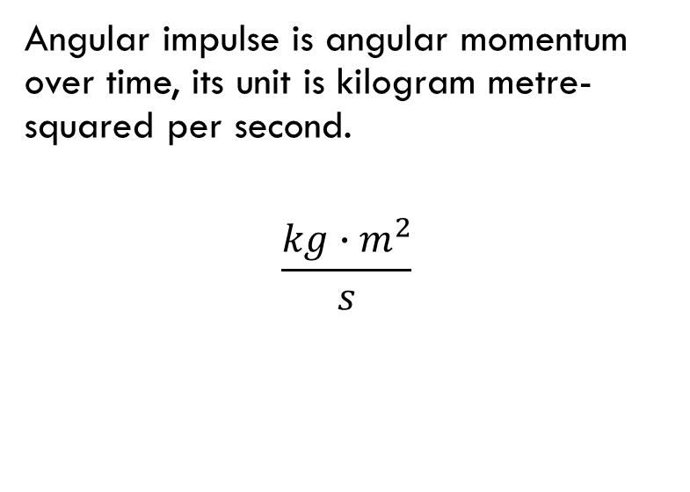



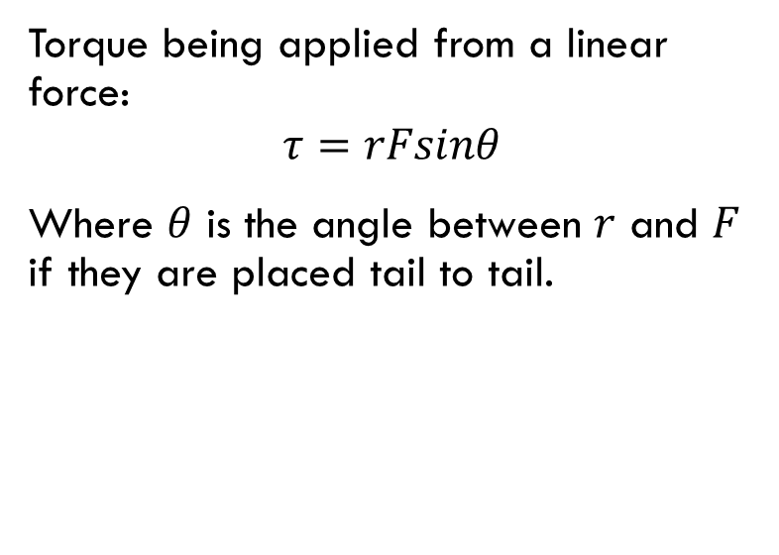

Angular Impulse
$$\sum{τ\left(t\right)=Iω_{f}−Iω_{i}}$$
$$\int_{t_{0}}^{t_{1}}{τdt=Iω_{f}−Iω_{i}}$$
Angular impulse is angular momentum over time, its unit is kilogram metre-squared per second.
$$\frac{kg∙m^{2}}{s}$$
Torque being applied from a linear force:
$$τ=rFsinθ$$
Where $θ$ is the angle between $r$ and $F$ if they are placed tail to tail.
$$F$$
$$θ$$
$$r$$

Slide 10
Fin
Next up, EPA and Collision Resolution in GJK

